Slide 1
Acoustic Modeling of Speaking Styles and Emotional Expressions in HMM-Based Speech Synthesis
Source: IEICE TRANS. INF. & SYST.
Author : Junichi YAMAGISHI, Takao KOBAYASHI
Professor : 陳嘉平
Reporter : 楊治鏞

Slide 2
Introduction
Recent research on speech synthesis has focused on generating emotional expressiveness and various speaking styles in synthesized speech.
In this paper, we describe an alternative approach that enables expressing various emotions and/or speaking styles easily and effectively in synthetic speech by using an HMM-based speech synthesis framework.

Slide 3
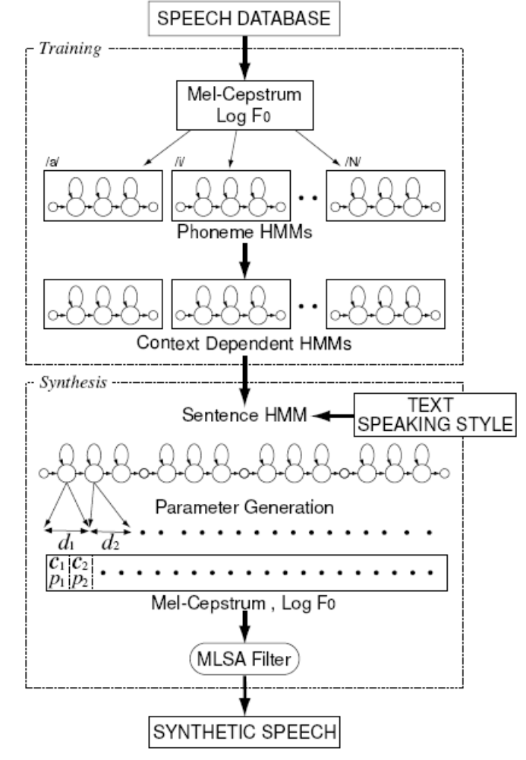

Slide 4
Style-dependent modeling
In the style-dependent modeling method, each style is modeled individually by using an acoustic model.
A pseudo root node is added to the resulting decision trees of each style to combine the models for all styles into a single acoustic model.

Slide 5
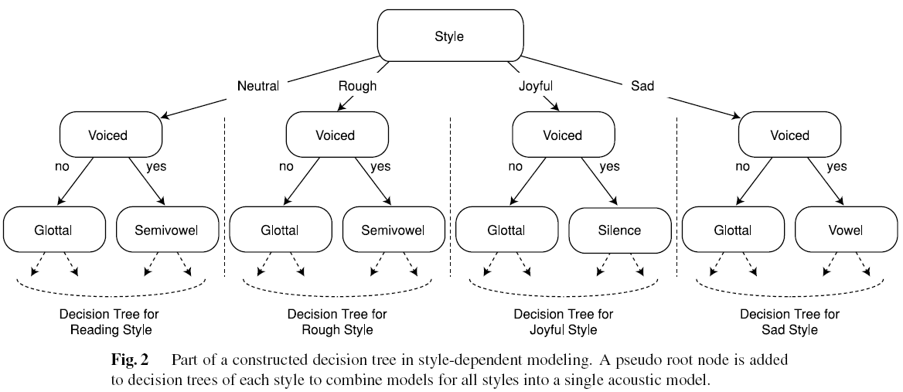

Slide 6
Style-mixed modeling
In the style-mixed modeling method, each style is treated as one of contexts, and the tree-based context clustering technique is applied to all styles at the same time.
As a result, all styles are modeled by using a single acoustic model as shown in Fig. 3.

Slide 7
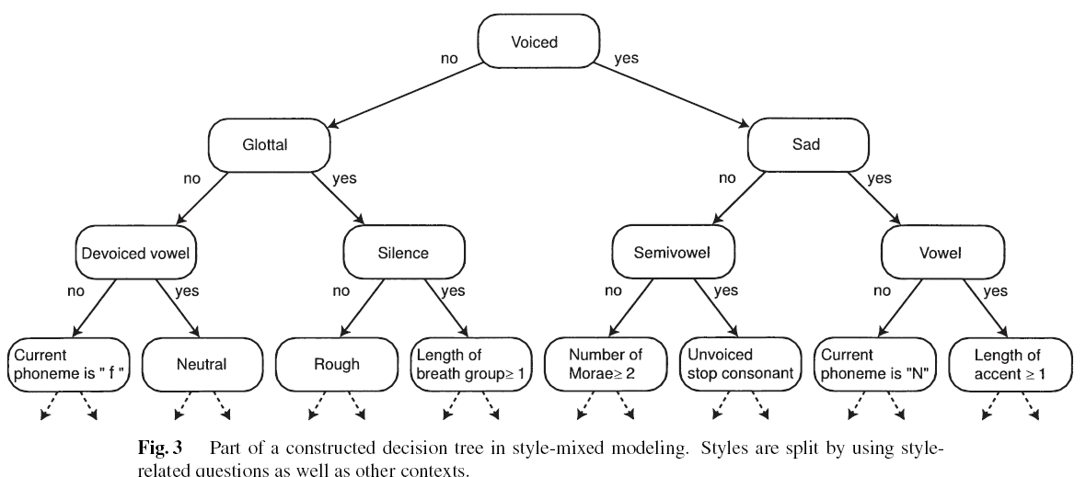

Slide 8
Experiments
To compare the proposed modeling methods, we chose four styles of read speech — polite, rough/impolite, joyful, and sad — and constructed speech database, which were composed of 503 phonetically balanced sentences obtained from the ATR Japanese speech database.
All the sentences were uttered by a male speaker, MMI, and a female speaker, FTY, in all the styles.

Slide 9
Experiments
The feature vectors consisted of 25 mel-cepstral coefficients including the zeroth coefficient, the logarithm of the fundamental frequency, and their delta and delta-delta coefficients.
Both the style-dependent and style-mixed models were trained using 450 sentences for each style.
We also used speech samples uttered by the same speakers in a neutral style for reference purposes.

Slide 10
Speech Database
We first evaluated whether the recorded speech samples were perceived by listeners as being uttered in the intended styles.
Nine male subjects were presented with all 503 sentences uttered in each of the styles and then asked whether they perceived the speech samples as having been uttered in the intended styles.

Slide 11
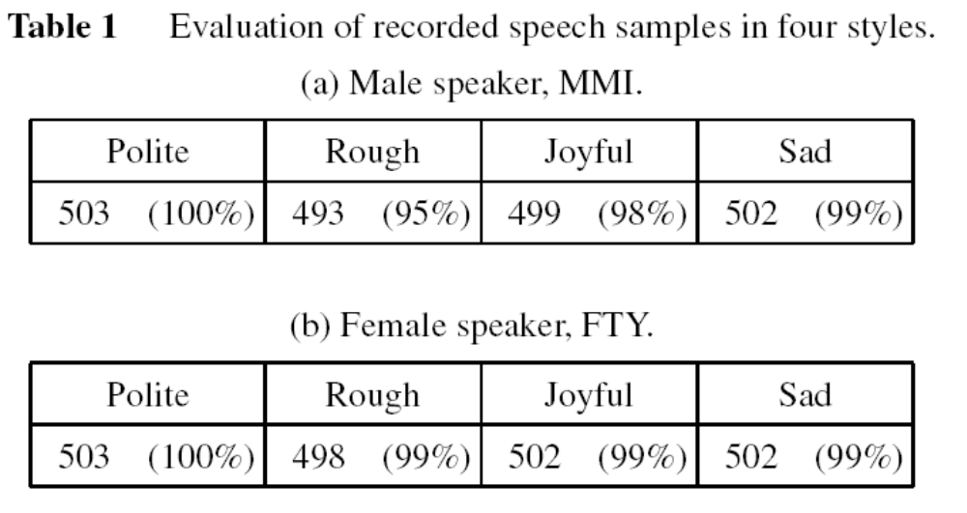

Slide 12
Speech Database
Nine male subjects were asked to assign eight test sentences chosen at random from 53 test sentences to a neutral, polite, rough, joyful, or sad group.
Speech samples that were not put by the subjects into one of these groups were classified as “other”.

Slide 13
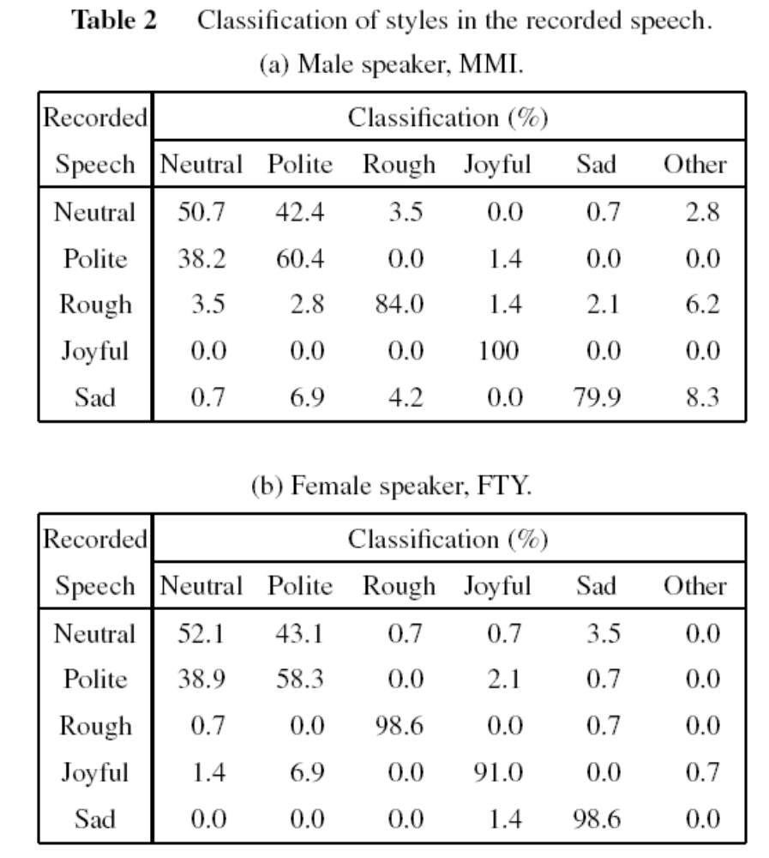

Slide 14
Subjective Evaluations of Styles in Synthesized Speech
Eleven male subjects were asked to classify eight test sentences chosen at random from 53 test sentences not included in the training data as being neutral, rough, joyful, or sad depending on the style of speech.
In these experiments, more than 80% of speech samples generated using both models were judged to be similar to those in the target styles.

Slide 15
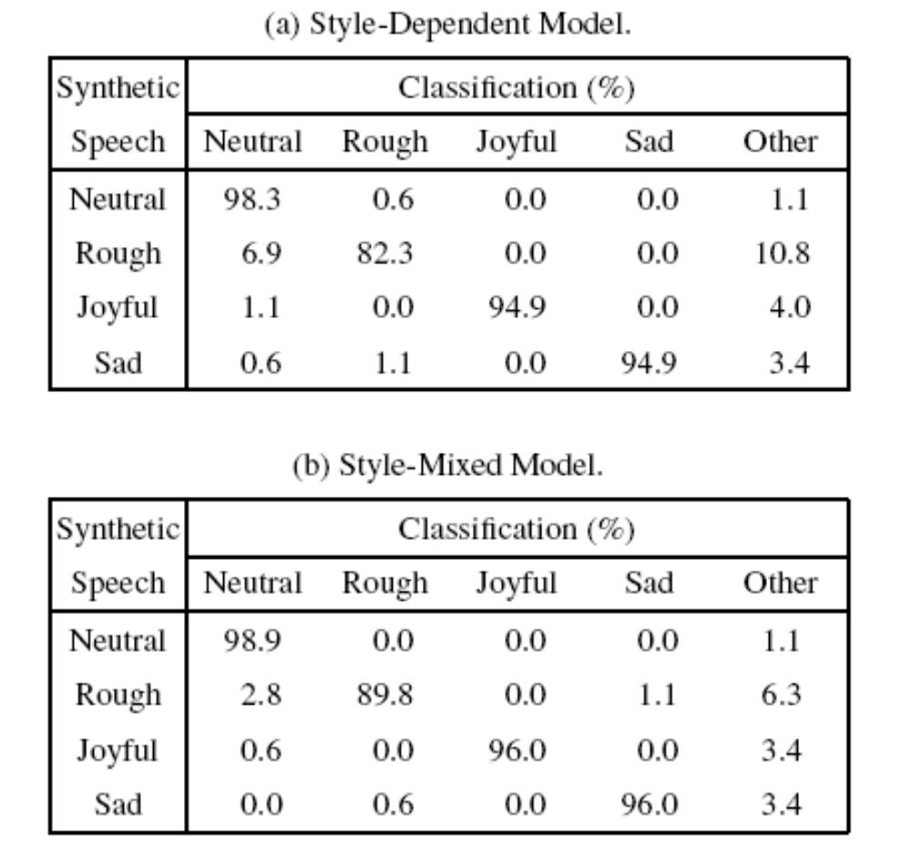
MMI

Slide 16
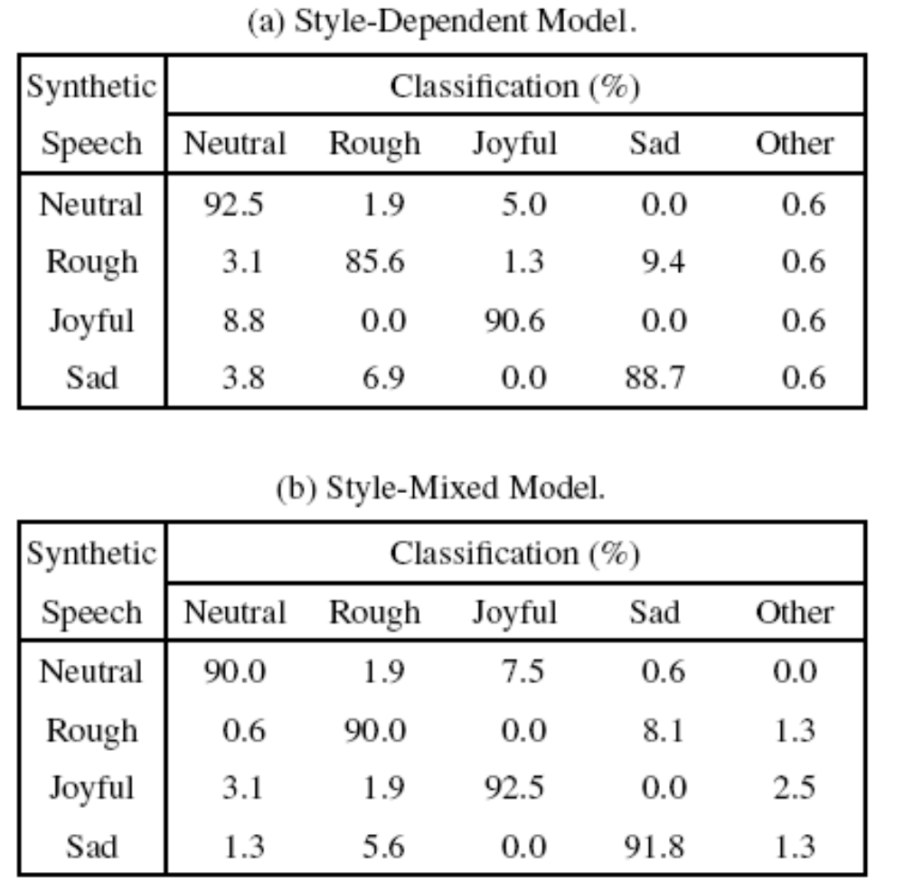
FTY

Slide 17
Subjective Evaluations of Naturalness
We conducted a subjective evaluation test to rate the naturalness of the speech synthesized by using the style-dependent model.
Ten subjects listened to eight sentences chosen randomly from 53 test sentences and then they rated the naturalness of the synthesized speech.
A 3-point scale was used with 3 for “good”, 2 for “acceptable”, and 1 for “bad”.

Slide 18
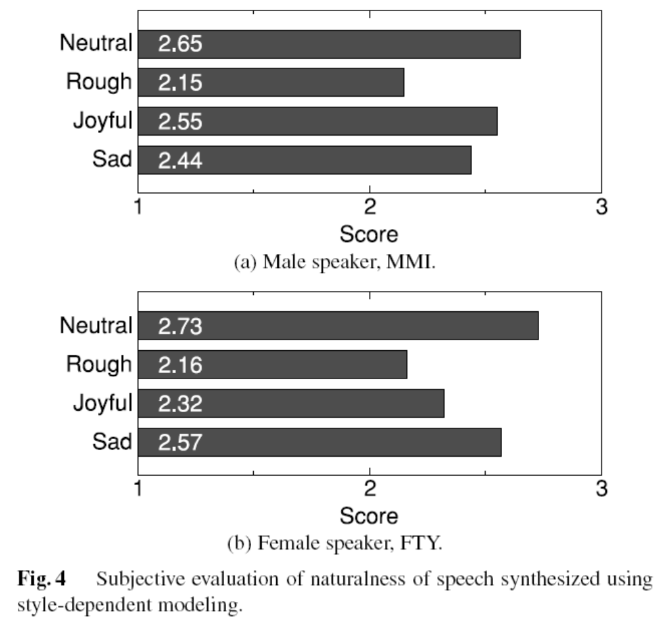

Slide 19
Subjective Evaluations of Naturalness
Sixteen male subjects were presented, in random order, with a pair of same-style speech samples synthesized using the two models, and then they were asked which synthesized speech sounded more natural.
For each subject, four test sentences were chosen at random from 53 test sentences not included in the training data.

Slide 20
